Slide 1
Chapter 12 Making the Right Career Choice

Slide 2
Assess Your Strengths and Set Goals
It is important that you honestly appraise your skills and competencies regularly.
Many of your skills and competencies will be based on work or life experience before coming to college.
Has anyone ever asked you where you expect to be in ten years? Do you know your answer?

Slide 3
Careers and the New Economy
Base your decisions about major and career path on:
Information about yourself
Long-term demands of the job market
To make timely decisions about your major and career path, you need to know about the underlying factors that drive today’s economy.

Slide 4

Characteristics of Today’s Economy
It’s GLOBAL
It’s FAST
It’s DISRUPTIVE
What are some other characteristics of today’s economy?
Notes:
Instructors: Other characteristics of the economy discussed in the chapter are:
Innovative
No boundaries
Customized
Ever-changing
Networked

Slide 5
Building a Professional Mindset for Life after College
There are no guarantees that you will immediately get a job.
You will need to take some risks to maintain and advance your career.
Your first job is seldom your dream job.

Slide 6
Working with an Academic Adviser
Prepare for your first meeting for a valuable experience.
Explore course options and pay attention to grades
Know how to deal with a mismatch between you and your adviser
Know the right questions to ask about your major
Learn how to select your classes
Notes:
Instructors: Below are some tips to share with students about working with an academic adviser:
Prepare for the first meeting by:
Look at the course catalog.
Think about the available majors.
Become familiar with campus resources.
Prepare materials to bring to the meeting.
Make a list of majors that appeal to you.
Map out your time frame and goals.
Some of the right questions to ask about a major:
How many credits must I take each term to graduate on time?
What are the prerequisites and corequisites for my major?
If I have any AP credits or dual enrollment credits, can I use them to fulfill some of my major’s requirements?
Know how to deal with a mismatch:
Talk to your college success instructor if you feel that you need to be assigned to a different adviser.

Slide 7

Finding Career Resources on Your Campus
Engage in at least one career center–sponsored event per term.
Build your professional network daily.
Work to develop a mentor.

Slide 8
The Career Center Website
Explore the career center website for career planning resources:

Slide 9

Getting to Know Yourself
Reflecting honestly about yourself in college can help you make decisions about college and life.
Assess your career competencies.
Provide insights that provoke a conversation with yourself, your mentor, and/or your career advisor.

Slide 10
Personal and Workplace Values
During your college experience your values will become clearer. Clarify your personal and workplace values.
Personal values reflect your need for family, security, integrity, wealth, compassion, fairness, creativity, ambition, adaptability, and personal fulfillment.
Workplace values are the values held by a company or organization.

Slide 11
Skills
Skills typically fall into three categories:
Personal: natural or learned through experience
Workplace: learned on the job
Transferable: gained through previous experience or everyday life and can be transferred to another job

Slide 12
Aptitudes
Aptitudes are aptitudes your acquired or natural ability for learning. They make it easier for you to learn or do certain things.
Proficiency in a particular area
Manual dexterity, musical ability, spatial visualization are examples.
What are your natural abilities?

Slide 13
Personality and Interests
Personality
Makes you who you are
Shouldn’t ignore when making career decisions
Interests
Shape and define our career paths
Good career exploration begins with considering what you like to do and relating that to your career choices

Slide 14
The Holland Model
The Holland Model organizes career fields into six general categories
Career fields grouped according to what is required and what rewards are provided
Can help you identify career fields consistent with what you know about yourself
Can help you identify areas of harmony or conflict in your career choices

Slide 15
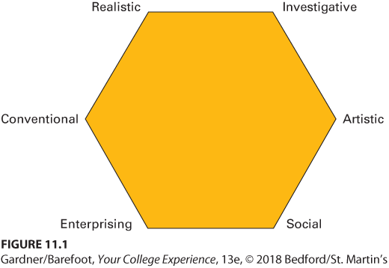
Holland’s Hexagonal Model of Career Fields

Slide 16
Tech Tip: Conduct Industry Research
Spend more time online exploring career resources
Visit O*NET OnLine
Search by keyword or occupational category
Identify companies or organizations of interest within a larger industry
Do research on individual employers of interest
Notes:
Some apps for note taking include:
Pocket
Evernote
CamScanner
Scan Edit
Tiny Tap
StudyBlue

Slide 17

Gaining Professional Experience
Once you have determined your interests and career goals, you can start to gain experience that will move you toward your goals through:
Internships and other professional work experiences
Part-time work in college

Slide 18
Make Good Choices
Let previous work experience guide future career choices.
What kind of jobs have you had, either for pay or as a volunteer?
Why did you choose those jobs?
Which of them was your favorite, and which did you dislike?

Slide 19
Tech Tip: Join the Professional Community
To research a professional community that you’re interested in joining:
Conduct industry and career research.
Do some research on yourself.
Get familiar with professional organizations.
Find ways to gain real experience.

Slide 20

Branding “You, Inc.”
Your brand consists of what you bring to the table in terms of knowledge, skills, attitudes, behavior, and values. Some points to consider when building your brand:
It begins the first day on campus.
If you don’t do it, no one else will.
Realize that it isn’t all about you.
Actions speak louder than words.

Slide 21
Building a Résumé
A good résumé is necessary to market yourself:
Choose between the chronological or skills-based formats.
Employers spend 7 to 10 seconds screening each resume.
A single page is usually appropriate.

Slide 22
Cover Letter
A cover letter is more important than a résumé and much harder to write well.
Written to explain how hiring you will benefit the organization.
An excellent way to market yourself to potential employers.
Remember to address it to the right person and proofread carefully.

Slide 23
Reflection
Understand the nature of the new economy you will be entering.
Finding a career is about more than just the job. It’s also about how and where you want to live and with whom. Does the career you envision fit with the way you want to live your life?

